Slide 1

Unit 3
Logic Functions
College of Computer and Information Sciences
Department of Computer Science
CSC 220: Computer Organization

Slide 2
Logic Functions
Number of functions
  With N logical variables, we can define
  2^{N} combination of inputs
  A function relates outputs to inputs
  Some of them are useful
    AND, NAND, NOR, XOR, …
  Some are not useful:
    Output is always 1
    Output is always 0

Slide 3
Logic Functions
Logical functions can be expressed in several ways:
  Truth table
  Logical expressions
  Graphical form
Example:
  Majority function
    Output is one whenever majority of inputs is 1
    We use 3-input majority function

Slide 4
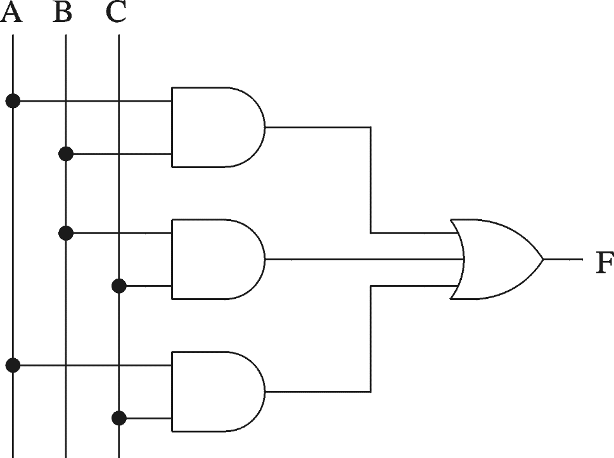
Logic Functions (cont.)
3-input majority function
A B C F
0 0 0 0
0 0 1 0
0 1 0 0
0 1 1 1
1 0 0 0
1 0 1 1
1 1 0 1
1 1 1 1
Logical expression form
F = A B + B C + A C

Slide 5
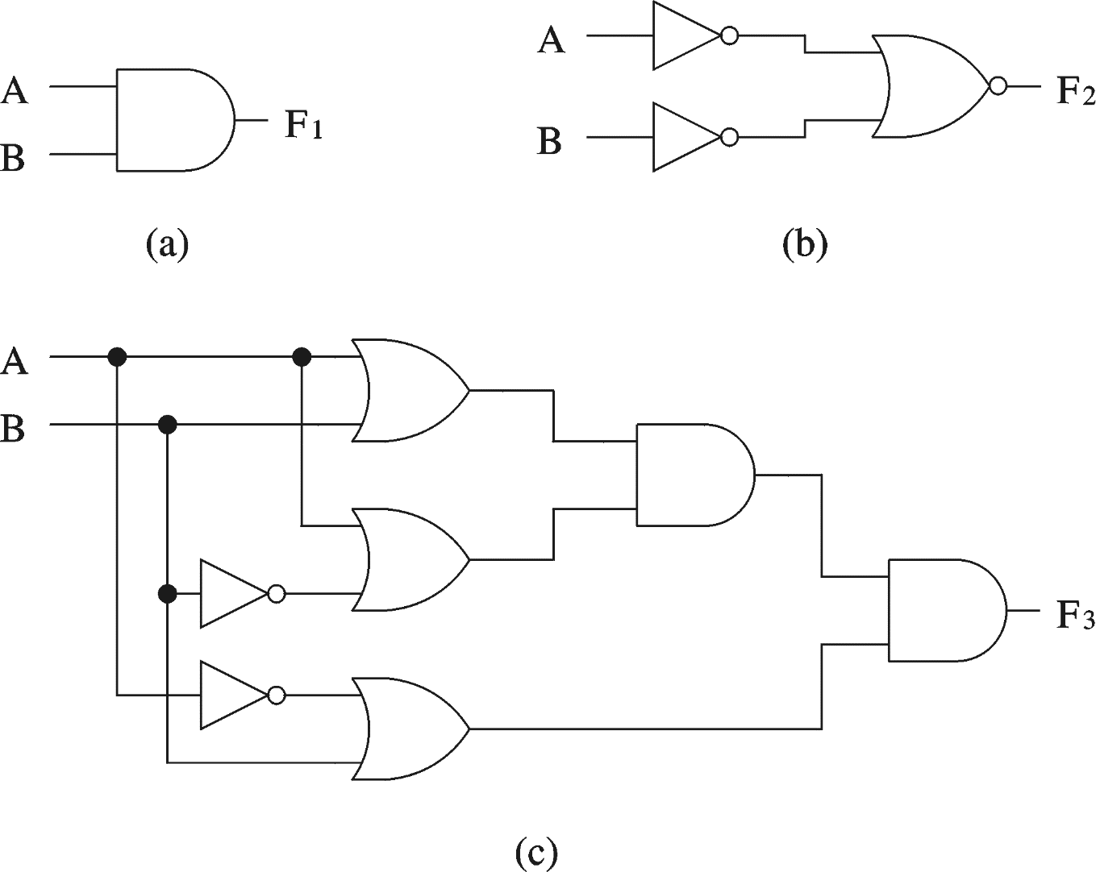
Logical Equivalence
All three circuits implement F = A B function

Slide 6
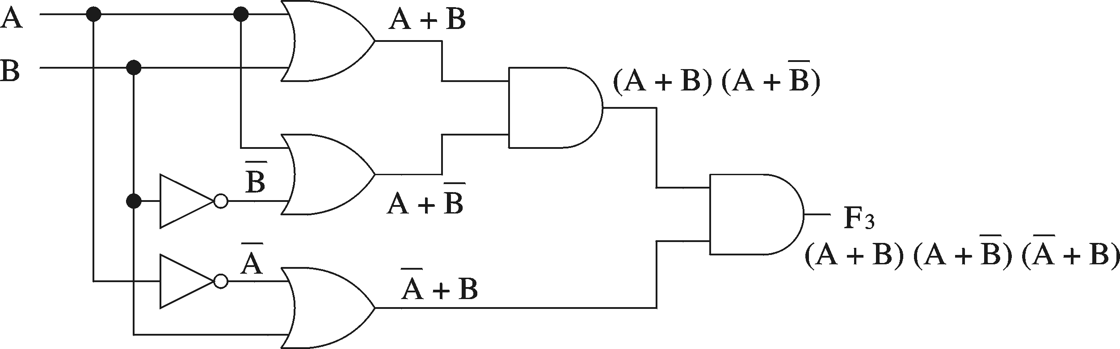
Logical Equivalence
Derivation of logical expression from a circuit
  Trace from the input to output
    Write down intermediate logical expressions along the path

Slide 7
Logical Equivalence (cont.)
Proving logical equivalence: Truth table method
  A B F1 = A B F3 = (A + B) (A + B) (A + B)
  0 0 0 0
  0 1 0 0
  1 0 0 0
  1 1 1 1

Slide 8
Digital logic function :
SOP and POS forms

Slide 9
Standard Forms for
Boolean Expressions
Sum-of-Products (SOP)
  Derived from the Truth table for a function by considering those rows for which F = 1.
  The logical sum (OR) of product (AND) terms.
  Realized using an AND-OR circuit.
Product-of-Sums (POS)
  Derived from the Truth table for a function by considering those rows for which F = 0.
  The logical product (AND) of sum (OR) terms.
  Realized using an OR-AND circuit.

Slide 10
Sum-of-Products (SOP)

Slide 11
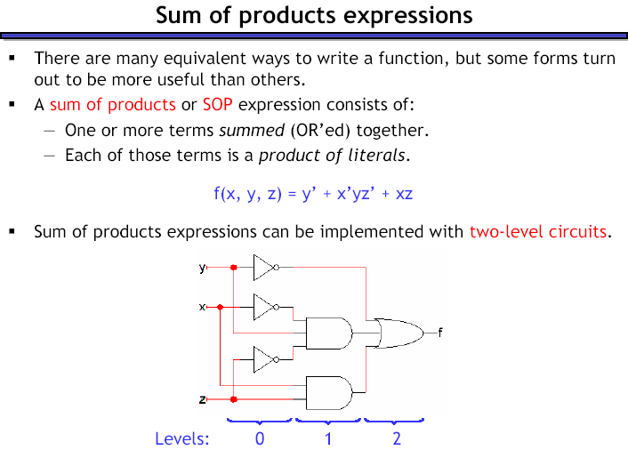
1

Slide 12
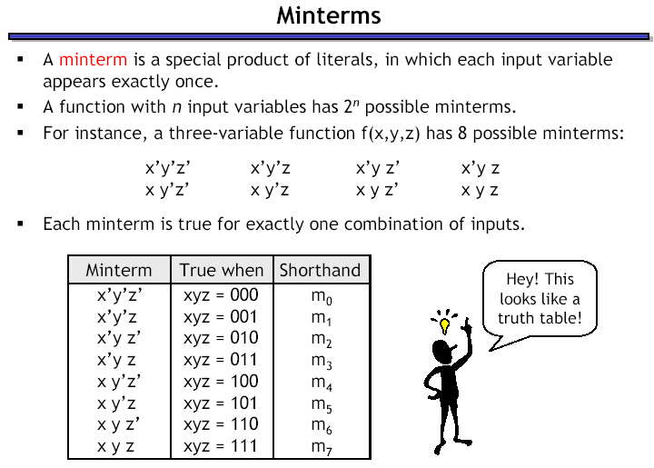

Slide 13




Minterms

Slide 14
Sum-of-Products
Any function F can be represented by a sum of minterms, where each minterm is ANDed with the corresponding value of the output for F.
  F = Σ (m_{i} . f_{i})
    where m_{i} is a minterm
    and f_{i} is the corresponding functional output
  Only the minterms for which f_{i} = 1 appear in the expression for function F.
  F = Σ (m_{i}) = Σ m(i)
Denotes the logical
sum operation
shorthand notation

Slide 15
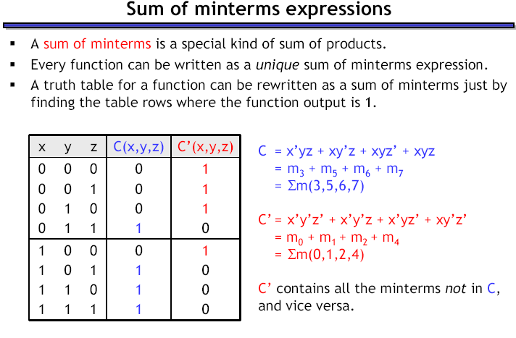

Slide 16
Sum-of-Products
Sum of minterms are a.k.a. Canonical Sum-of-Products
Synthesis process
  Determine the Canonical Sum-of-Products
  Use Boolean Algebra (and K-maps) to find an optimal, functionally equivalent, expression.

Slide 17
Product-of-Sums (POS)

Slide 18
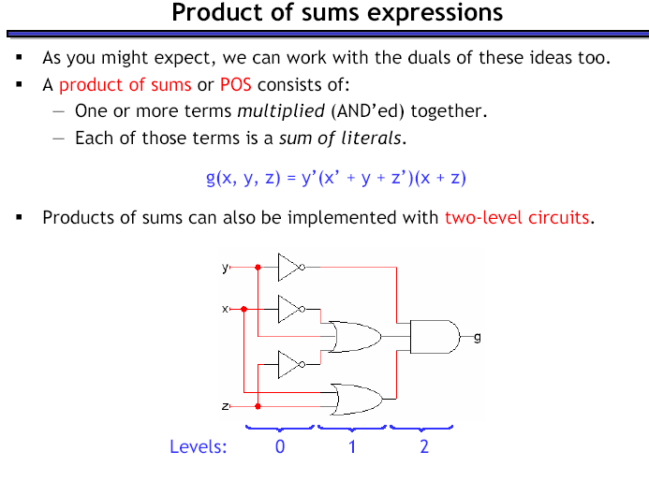
2

Slide 19
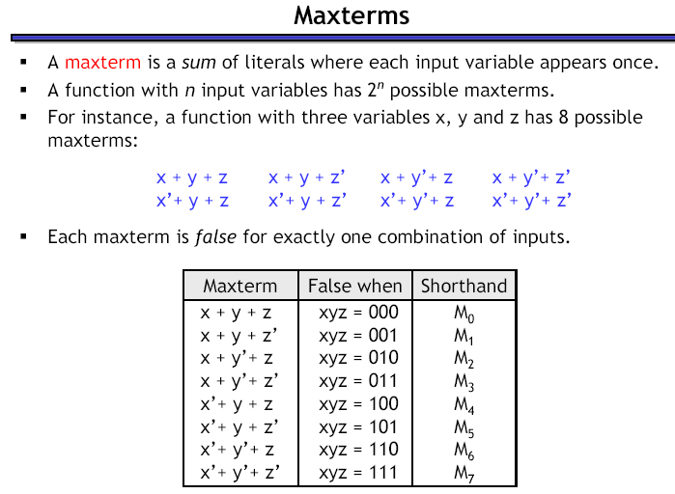

Slide 20
Maxterms

Slide 21
Product-of-Sums
Any function F can be represented by a product of Maxterms, where each Maxterm is ANDed with the complement of the corresponding value of the output for F.
  F = Π (M_{i} . f '_{i})
    where M_{i} is a Maxterm
    and f '_{i} is the complement of the corresponding functional output
  Only the Maxterms for which f_{i} = 0 appear in the expression for function F.
  F = Π (M_{i}) = Π M(i)
Denotes the logical
product operation
shorthand notation

Slide 22
Product-of-Sums
The Canonical Product-of-Sums for function F is the Product-of-Sums expression in which each sum term is a Maxterm.
Synthesis process
  Determine the Canonical Product-of-Sums
  Use Boolean Algebra (and K-maps) to find an optimal, functionally equivalent, expression.

Slide 23
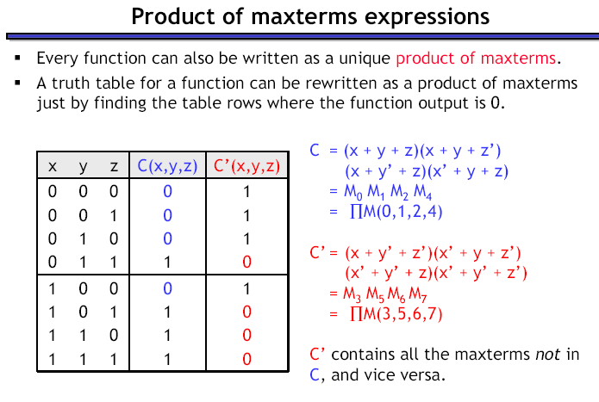

0
When the o/p is Zero
When the o/p is 1

